Slide 1

Hypothesis Testing

Slide 2
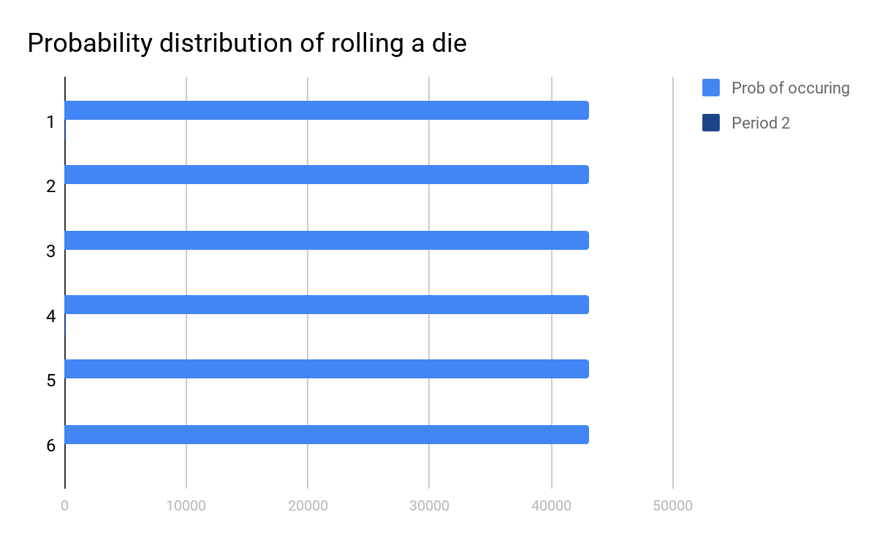
Re-cap: Probability Distributions
Probabiltity distributions describe the probabilities of all values of a random variable [X] occuring. So, the below is the prob. Distribution for a die

Slide 3
Standardized Variables
Two ways of describing probability distributions:
Mean and Standard deviation
if two or more random variables have the same mean and standard deviation, they are said to be standardized.
To standardize a random variable, we substract its mean, and then divide it by its standard deviation :
Insert formula here

Slide 4
Standardized Variables (contd.)
No matter what the initial units of X, the standardized random variable Z has a mean of 0 and a standard deviation of 1.
The standardized variable Z measures how many standard deviations X is above or below its mean.
Instead of saying that a woman is 71 inches tall (which is useful for some purposes, such as clothing sizes), we can say that her height is two standard deviations above the mean (which is useful for other purposes, such as com- paring her height with the heights of other women).

Slide 5
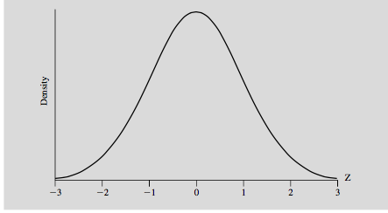
Normal distribution and the Central Limit Theorem
The theorem states that if Z is a standardized sum of N independent, identically distributed (discrete or continuous) random variables with a finite, nonzero standard deviation, then the probability distribution of Z approaches the normal distribution as N increases.
A normal distribution is just a bell shaped curve

Slide 6
contd...
The normal distribution is important because it so often appears even when N is quite small. An N above 30 is usually sufficient to achieve a normal distribution.
The 68,95,99 rule:
P[-1 < Z <1]= 0.68
P[-2 < Z < 2]= 0.95
P[-3 < Z < 3] = 0.99

Slide 7
Sampling
Until now, our discussions of probability distributions, means and standard deviatios have been actually about the Population. The population is the entire group of items that interests us.
To say the “mean height of indian men” can either imply
The enitire population of indian was used to determine the mean
A sample of indian men were randomly selected to be repesentational of the population.
Often we are unable to measure the entire population and are left taking samples of the population. Care must be taken in infering or estimating from the sample.

Slide 8
Estimation
Let X_{bytemean} be the “sample average” of the 30 students in our class. This was calculated using
It is tempting to regard a sample average as definitive. Our particular sample is just one of many samples that might have been selected; other samples would yield somewhat different sample averages.
But we can use probabilities to deduce how likely it is that a sample will be selected whose mean is close to the population mean.

Slide 9

Sample mean and standard deivation
The mean and standard deviation of our sample are similar to the population mean and standard deviation:
We will use these to determine the confidence interval that the sample mean is close to the population mean.

Slide 10
Students t-distribution
A statistician, Gosset, found that sample distributions, for samples larger than 30, were also normally distributed. This means that now we can use the normal distribution to determine the likelihood of an event occurring.
In the example we will take, we will analyze the likelihood of a sample mean occurring. Specifically, we will create an interval such that we want to be 95% (or some other %-level) sure that our interval encompasses the true population mean.
So given a sample mean, we are evaluating its proximity to the true mean by creating an interval in which there is say, a 0.95 probability that our true population will be somewhere in this interval.

Slide 11

CI formula
So we are standardizing our sample data. Then we are choosing a level of confidence we want (how sure we want to be of our results) and then we use the above formula.

Slide 12
Example: Creating a 95% and 99% confidence interval
A group of 10 foot surgery patients had a mean weight of 240 pounds. The sample standard deviation was 25 pounds. Find a confidence interval for a sample for the true mean weight of all foot surgery patients. Find a 95% CI.
Step 1: Find Degrees of Freedom = N-1 = 10-1 = 9
Step 2: Choose a confidence level (0.05) and divide by 2 = 0.025
Step 3: Identify a critical t using Students t- table = 2.262
Step 4: Calculate sample standard error = 25/sq.root(10) = 7.9

Slide 13
contd.
Step 5: Plug in the values to the formula
240 + 2.62(7.9)
The lowerbound is 222.117 and the upper is 257.8. Now we can say that there is a 0.95 probability that the sample average will be between these two numbers if we re-sampled and calculated the interval a 100 times.
For the 99% level,
240 + 3.25(7.9)
We notice that if we want to be more sure of our result we have a wider interval.

Slide 14
Hypothesis Testing
In Hypothesis testing, our goal is to evaluate our results. Specifically, to understand if our results are statistically significant or not. Is it likely that our results could have been obtained by chance?
Example: While licensing new medicines, the Central Drugs Standard Control test the medicines for side effects. If the sample of people exposed to the new product shows some side effect significantly more frequently than would be expected to occur by chance, the product is held back.
This is not PROOF that the medicines have side effects, but with a certain level of confidence/significance (95%) we can state these results are unlikely “normal”.

Slide 15
Setting up: Null and Alternative Hypothesis
H₀: The Null Hypothesis states the “default”. For example, in the medicines our default is that the medicines have no side-effects. This may be proxied by saying that blood pressure levels are “normal/average”.
H_{a}: The Alternative Hypothesis is the opposite of the default. In our example, this may be that blood pressure level are NOT “normal/average”. Another valid alternative hypothesis is that the blood pressure level are ABOVE “normal/average”.
H₀: B_{pre-medicine} = B_{post-medicine}
H_{a}:B_{pre-medicine} ≄B_{post-medicine}

Slide 16
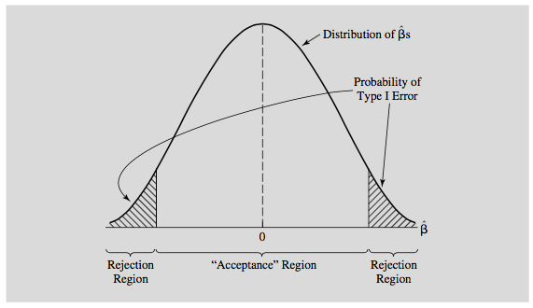
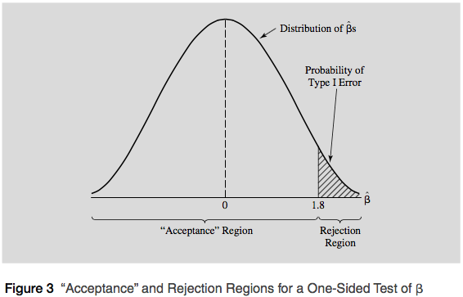
Setting up: contd.
There are two types of alternative hypothesis. One where we are “agnostic” and do not suppose to know the direction of change. This is a two-sided test.
On the other hand, we may have a suspicion (for example that the medicine increases blood pressure and test for that specifically. This is a one-sided test.

Slide 17
Type I and Type II error
We can possibly make one of two errors in hypothesis testing:
Type I: We reject a true null hypothesis.
Type II: We do not reject a false null hypothesis.
So in our medicinces example, a type I error would be reject the null hypothesis that there is no blood pressure variation when in fact the opposite was true.
A type II error would be to not reject the Null when we should have.
A type II error is usually more critical to avoid than Type I.

Slide 18
Making a decision: Accepting or Rejecting the Null
To accept or reject the null hypothesis we need a critical t-value.A critical t-value is the value that distinguishes the “acceptance” region from the rejection region.
The rejection region measures the probability of a Type I Error if the null hypothesis is true. Unfortunately, decreasing the chance of a Type I Error means increasing the chance of a Type II Error since if you make the rejection region so small that you almost never reject a true null hypothesis, then you’re going to be unable to reject almost every null hypothesis, whether they’re true or not!
So, after choosing a critical t, we the t-value for our particular observation (t_{k}) and compare it with the critical t. We Reject H₀ if |t_{k}| 􏰑> t_{c} and if t_{k} also has the sign implied by H_{A}. Do not reject H₀ otherwise.

Slide 19
Example: One sided t-test
Suppose we want to evaluate the impact of a diet plan. We have two groups of 30 people each, one which underwent to diet (control) and the other that underwent diet (intervention).
Prior to the study, each member of the group was 65kg. Below are the summary statistics of the two groups post the study.
No Diet Diet
Mean weight = 65 Mean weight = 64.1
S.D = 3.8 S.D = 3.4
S.E = 3.8/sq.root(30) S.E = 3.4/sq.root(30)

Slide 20
Example: contd.
What is our null and alternative hypothesis here?
Null hypothesis : No difference in weight loss between diet and no-diet
Alternative: Diet-takes experienced more weight loss than non-diet takers (ONE-SIDED)
Critical t : 1.6973

Slide 21
Example: contd.
Now we need to calculate our t-value (t_{k}) . This gives us the likelyhood of observing our mean values.
The total weight loss was 0.9kg. Was this significant?
T_{k} = 0.9 - 0 = 0.96
Since our (t_{k}) of 0.96 is less than our t_{c} of 1.69, we cannot reject the null.
0.93

Slide 22
Hypothesis Testing: Another Way
A p-value for a t-score is the probability of observing a t-score that size or larger
We don’t need to caclulate it as Sklearn and Statsmodel provide them for us.
It tells us the lowest level of significance at which we could reject the null hypothesis
So, if a p-value, always between 0 and 1, is low it is casting doubt on the null hypothesis and a high p-value is agreeing with null hypothesis. Here again, to reject or accept the null, we need a critical value and the common one is 0.05.
In our diet example, the P-value for conducting the one-sided test H₀ : μ_{pre-diet} = μ_{post-diet}versus H_{A} : μ_{pre-diet} < μ_{post-diet} is the probability that we would observe a test statistic greater than t* = 1.69 if the pre-diet mean μ was really equal to post-diet mean.

